Slide 1

Josh’s Portfolio

Slide 2
Overall Structure & Design

Slide 3
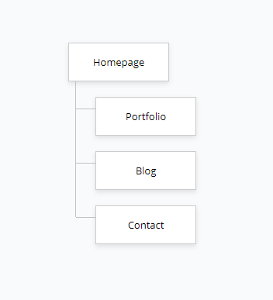
Sitemap

Slide 4
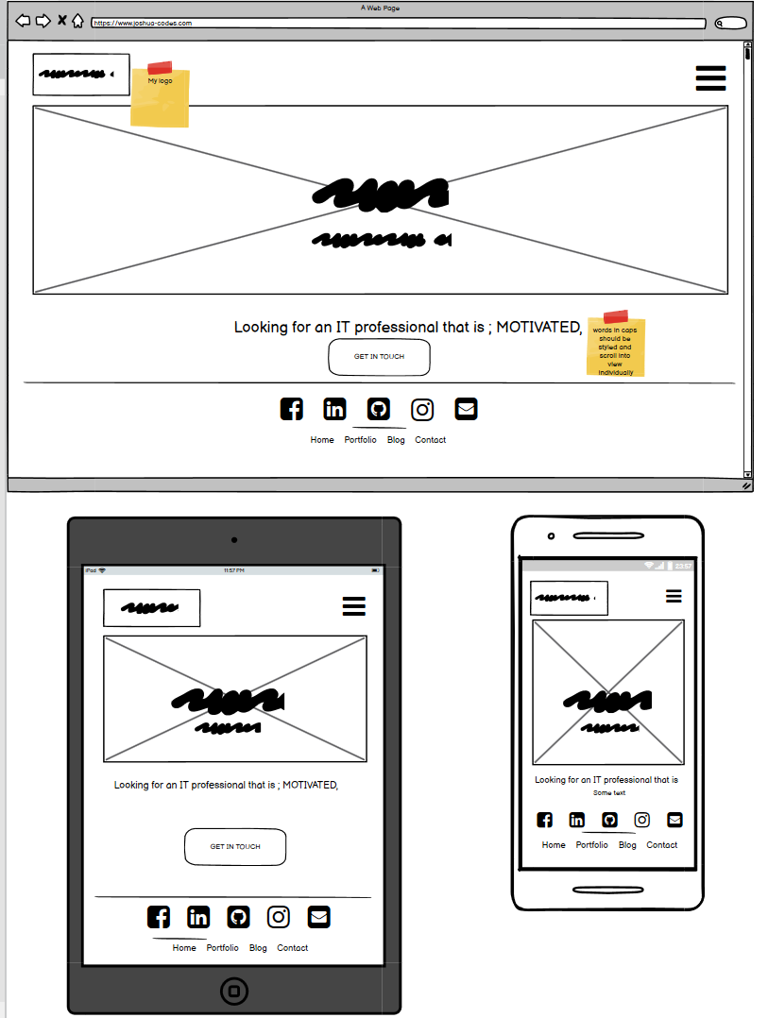
Wireframe

Slide 5
Design & feel
Structure
An overall colour theme was used to display continuity and tie the pages together
Brand logo displayed on every page, top left to keep the brand name in the browsers mind
Soft colours were used to encourage the feelings of being safe and comfortable
Background images used to relay page content without having to read a heading, making it easier to process
Photos of individuals have rounded borders to draw focus to the person displayed in a friendly manner
Pointer cursor used to indicate links
Ux principles applied to buttons
Similar layout was used across all pages to display continuity, focus on content and improve ease of navigation for the user
Clickable logo that always links the user back to homepage
Navigational links displayed at top and bottom of screen
Hero header relating to the theme of the page as an intro to the page content
Main content displayed in center
Line-breaks used to signify change from content to footer
External links displayed at bottom

Slide 6
Components
Semantic html used to define document layout
All pages contain an image as an anchored link back to the homepage
Navbar
All pages contain a hero header excluding the blog page
Index page contains faux marquee constructed of paragraphs inside a wrapper and container
Divs used for ease of styling
Form added to contact page for easy communication
Anchored links styled as buttons
Transitions used on multiple elements

Slide 7
Target Audience & Purpose

Slide 8
Target Audience
Purpose
The target audience of this website is prospective employers, clients and individuals seeking professional advice or services.
The aim of this website is to convey an approachable, driven professional looking for work and clients. The purpose of the layout and design is to prompt the user to make initial contact.

Slide 9






Tech stack

